Slide 1

AIRBND HOTEL BOOKING ANALYSIS
ADHITHYA LP
STU6747223ca9a731732715068

Slide 2

PROBLEM STATEMENT
Airbnb is a popular platform where property owners rent out their homes or apartments to travellers. One of the biggest challenges for hosts is deciding the right price for their listings, since prices vary depending on several factors such as the number of bedrooms, number of bathrooms, cleanliness, accuracy of descriptions, add communication quality with guests.

Slide 3
Project Description
This project focused on building a machine learning model to predict the price of Airbnb listings. Pricing an Airbnb property correctly is crucial for both hosts and travellers: hosts want to maximize occupancy and earnings, while travellers want fair and competitive prices. Using historical Airbnb data, the project develops a regression model that learns relationship between listing attributes (such as number of bedrooms, bathrooms and guest ratings) and the price charged.
The model can then be used to predict prices for new or hypothetical listings, helping property owners make informed pricing decisions.

Slide 4

WHO ARE THE END USERS?
Airbnb hosts:
To optimize pricing of the listings based on the property feature and guest reviews.
Travellers:
To evaluate whether a listing is overpriced or reasonably priced.
Airbnb platform Analysts:
To improve automated pricing suggestions and increase platform trust.
Research/students:
To study the impact of property features and reviews on rental pricing.

Slide 5

Technology Used
Python – Core programming language.
Pandas & Numpy – Data cleaning and preprocessing
Scikit-learn – Machine learning (model training, regression, evaluation).
Matplotlib/seaborn – Data visualisation and feature importance.
Google Colab – Cloud based environment for running the project.
File handling libraries – openpyxl (for Excel) and built-in CSV handling.

Slide 6
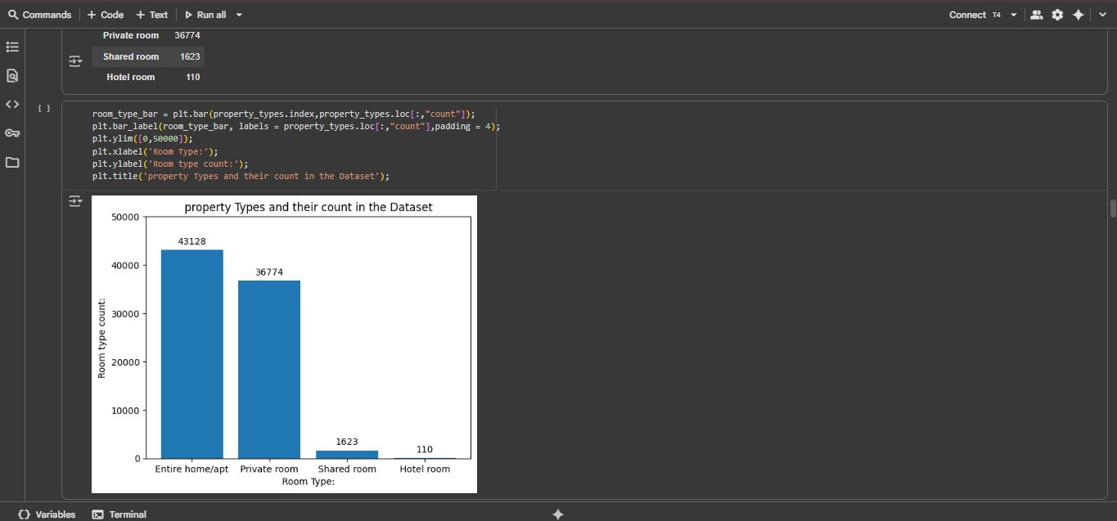
RESULTS1
Demo Link

Slide 7
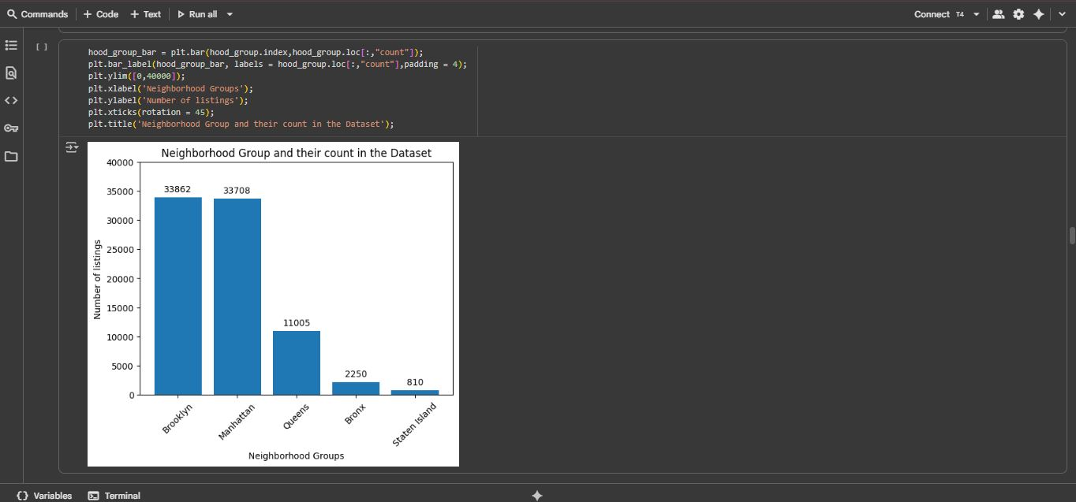
RESULTS2
Demo Link

Slide 8
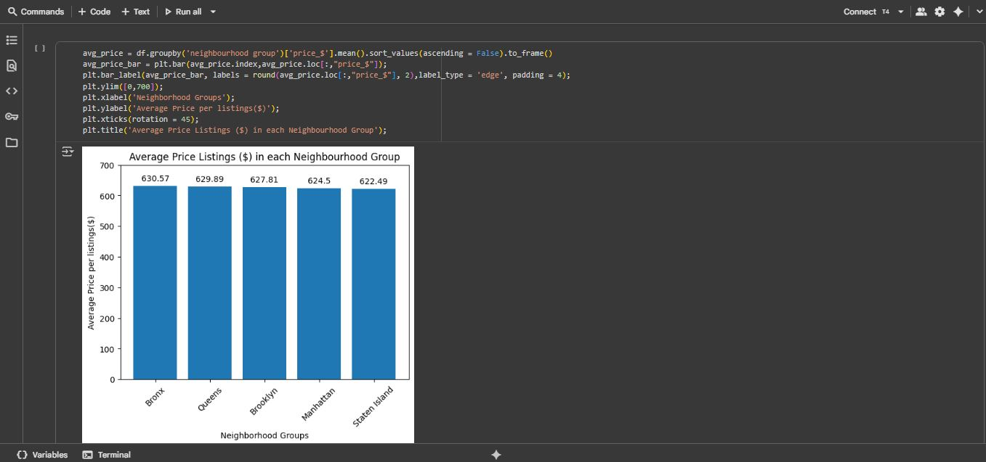
RESULTS3
Demo Link

Slide 9
GitHub repository
https://github.com/Adhi-1235/VOIS_AICTE_Oct2025_Adhithya.git
Demo Link

Slide 10
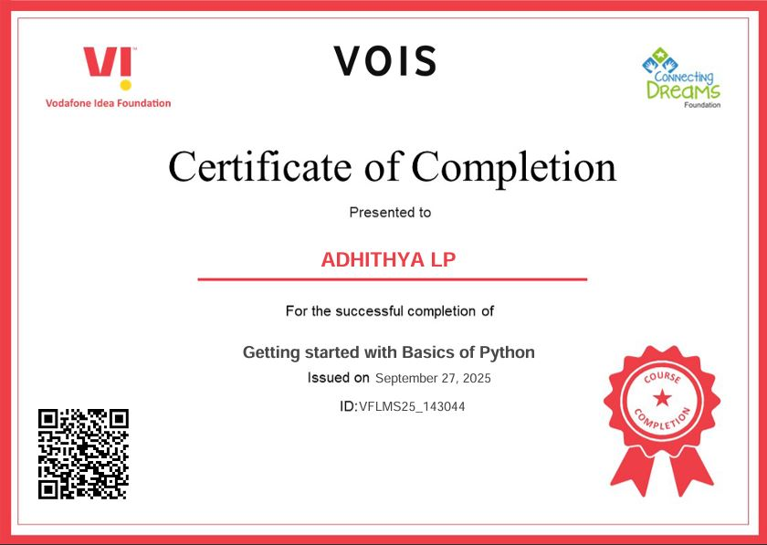
Getting started with Basics of Python Certificate

Slide 11
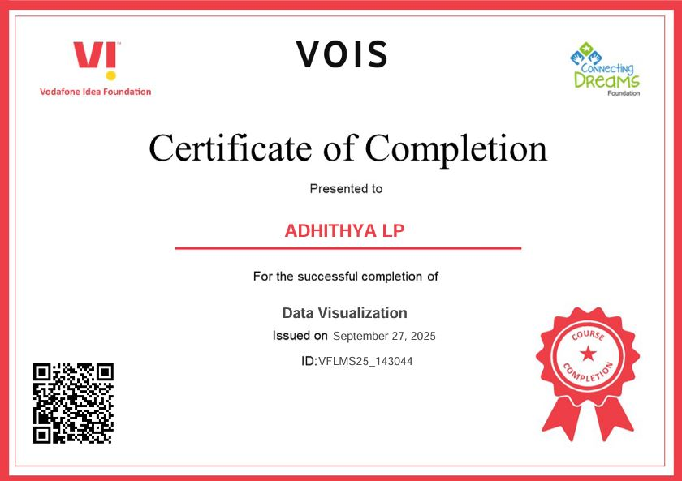
Data Visualization Certificate
[Paste your Certificate Here]

Slide 12
Thank you
.
.

